Slide 1
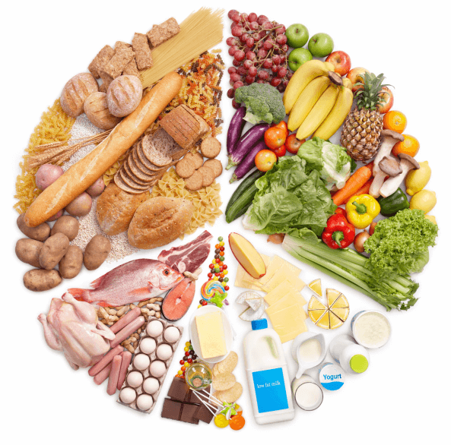
Economic crisis: a crisis on our plate?
1.3. Definition of food crisis
Food crisis is associated with issues of:
food production and supply
food safety
food quality
high prices
sustainable development (conservation of biodiversity, protection of the environment, etc.)

Slide 2
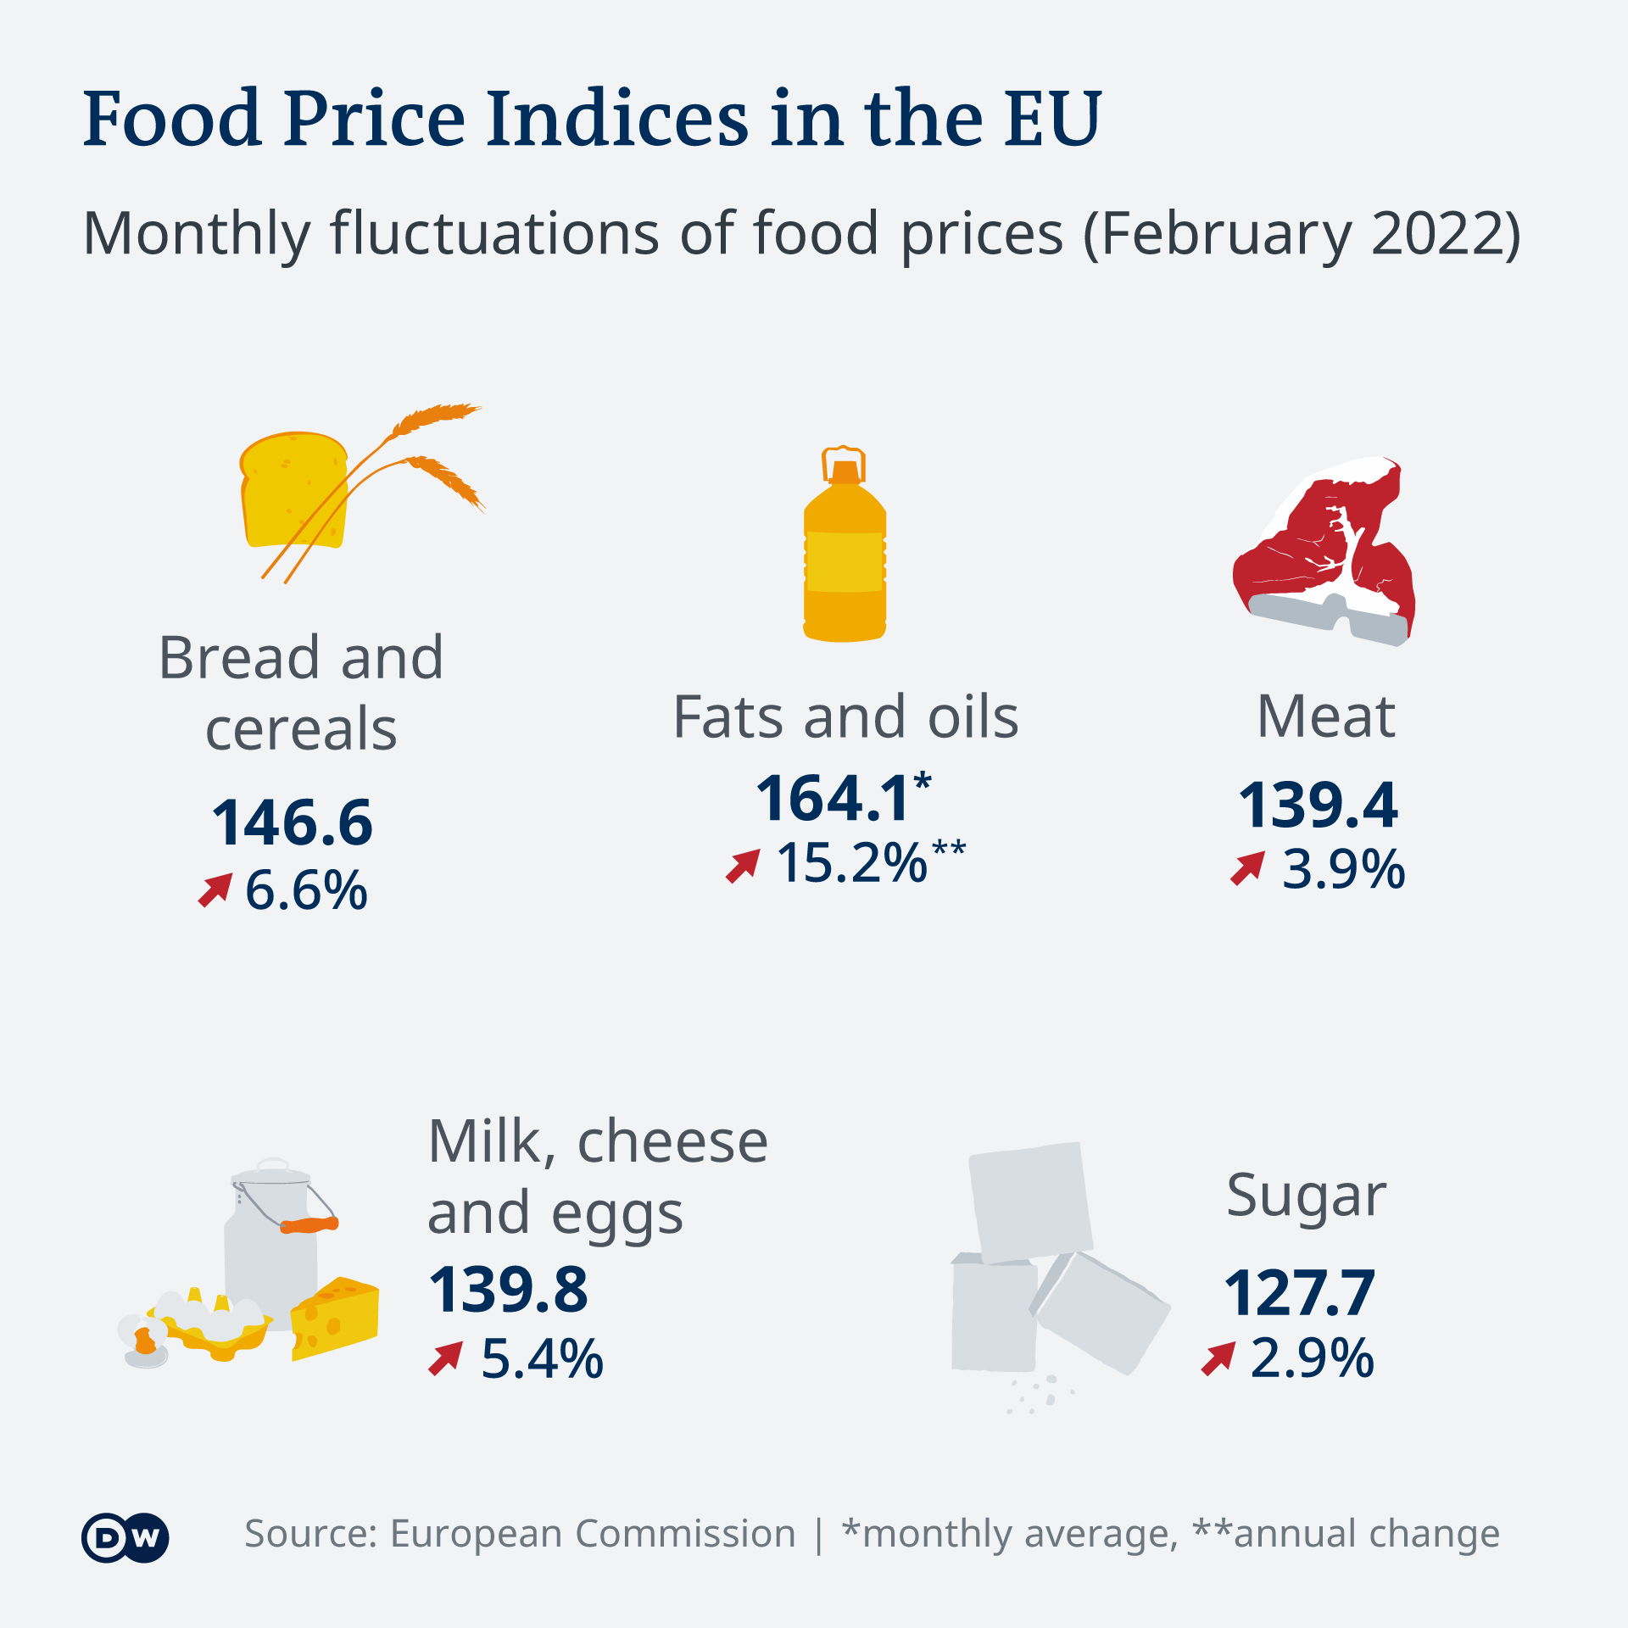
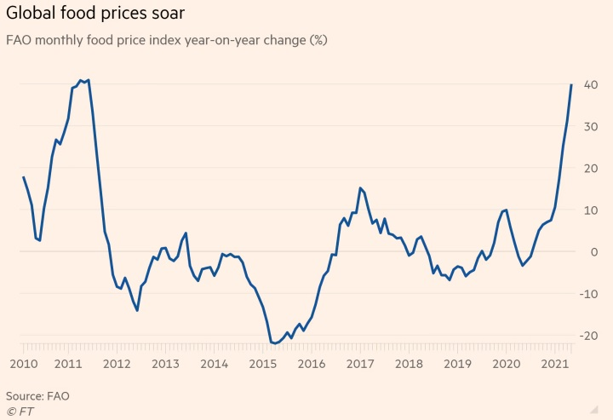
Economic crisis: a crisis on our plate?
1.3. Definition of food crisis

Slide 3
Economic crisis: a crisis on our plate?
1.4. The impact of food crisis on health
The impact of food crisis on health
→ Obesity, the metabolic syndrome, diabetes and heart disease have been shown to be more common in people who experienced periods of crisis and hunger during their fetal development or childhood years.
→ In order to meet their energy needs, people resort to foods with low nutritional value and at the same time high energy content, neglecting the quality of their food.
→ New research conducted in countries affected by economic crisis has shown that in times of economic hardship, dietary choices are not healthy.

Slide 4
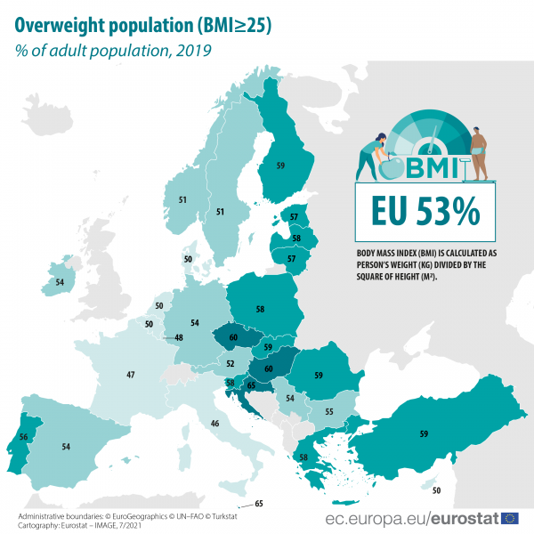
Economic crisis: a crisis on our plate?
1.4. The impact of food crisis on health

Slide 5
Economic crisis: a crisis on our plate?
1.5. Effects of the economic crisis on eating habits
→The cost of food is a primary determinant of their food choices (cost / income / socioeconomic status relationship).
→ The exact mechanisms by which financial hardship increases obesity levels are still under investigation and the most likely causes are: food prices, reduced physical activity due to limited access to gyms, stadiums, etc., cheap entertainment with TV at home and stress.
→ People of lower-income are more likely to adopt poor dietary choices and habits (although this does not always mean that higher financial comfort automatically equals to better food choices).
→ Studies have even shown that the lower the income, the higher the average body weight of adults and that obesity rates among poor people are higher.
→ Although in times of economic crisis one would expect more cases of malnutrition to be reported, international research records the so-called “hunger-obesity paradox”.
→ In Western societies, economic distress is rarely associated with malnutrition. On the contrary, very often the overall impression is that of weight gain which eventually lead to an increase in obesity.

Slide 6
Economic crisis: a crisis on our plate?
1.5. Effects of the economic crisis on eating habits
Reduction in fruit and vegetable consumption
Increase in junk food and alcohol consumption
Consumption of foods rich in sugar, salt, fats (saturated) and preservatives
Reduced level of physical activity
Reduction in fish consumption because it’s considered expensive

Slide 7
Economic crisis: a crisis on our plate?
1.6. Practical solutions for economical and rational dietary choices
Practical solutions for economical and rational dietary choices:
Adopt the Mediterranean diet. eating legumes once or twice a week and poultry (chicken or turkey) are economical and at the same time extremely healthy options.
In order not to leave out fresh food from your diet because it is 'expensive’, you can consume it in its frozen form. Its nutritional value may be less, but you will get some nutrients and save money.
Choose seasonal fruit and vegetables. They are usually cheaper but they also have better nutritional value than greenhouse or imported fruit and vegetables.
Many times food outside the home is a combination of being expensive and very low in nutrients. It would be better to limit its consumption.
In order to reduce the cost of your diet, cut down on the consumption of standard and packaged products, which, on the one hand, cost a lot, and, on the other hand, are usually rich in fat, salt and sugar.
“Recycle“ leftovers, e.g. use ripe fruit to make jam, or rice that was not consumed for salads (rice salad) etc.
Conduct your own market research and make a shopping list when you go to the supermarket.

Slide 8
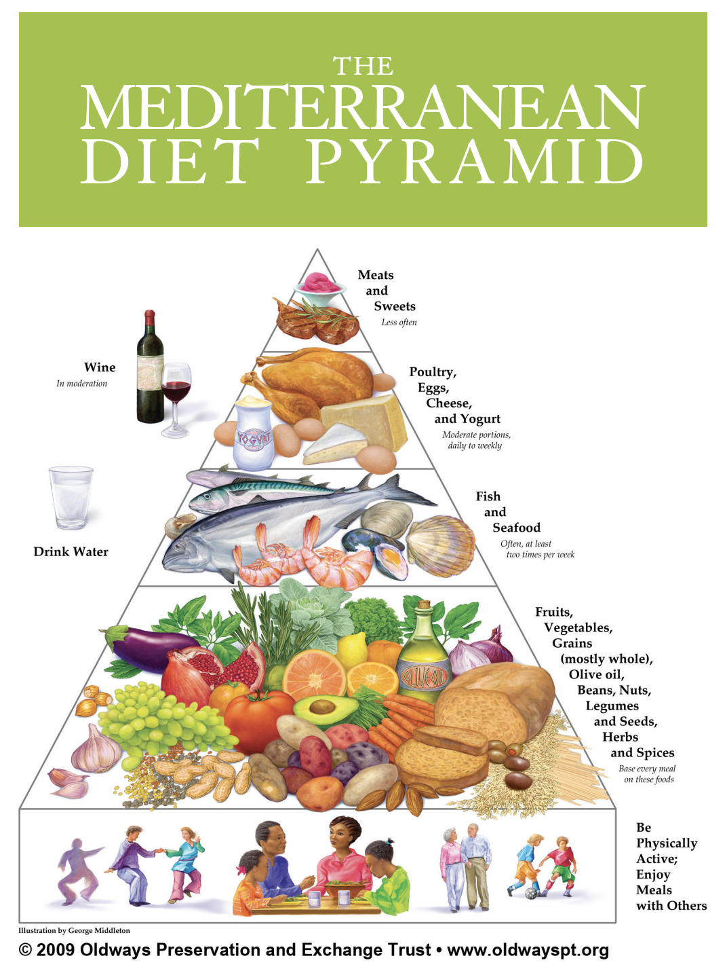
Economic crisis: a crisis on our plate?
1.6. Practical solutions for economical and rational dietary choices
In times of an economic crisis, adopting the traditional Mediterranean diet is the most appropriate "economic(al)" solution for maintaining health and ensuring the longevity of citizens!

