Slide 1
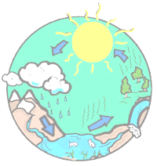
ACTIVITY NO. 3 – LESSON NO. 1
WHAT IS THE NAME OF THE MOVEMENT OF WATER ON EARTH?
FALLING WATER
THE WATER CIRCUIT

Slide 2
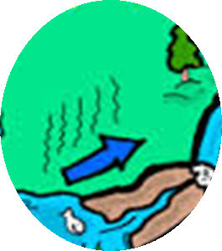
WHEN THE SUN HEATS WATER FROM RIVERS, LAKES OR OCEANS AND TURNS IT INTO STEAM, WE CALL THIS PROCESS…
EVAPORATION
CONDENSATION

Slide 3
WHEN WATER VAPOR COOLS AND FORMS CLOUDS, WE CALL THIS PROCESS ...
COLLECTION
CONDENSATION

Slide 4
WHWN THE CLOUDS SHAKE AND THE WATER FALLS TO THE GROUND IN THE FORM OF RAIN OR SNOW, WE SAY THAT THEY TAKE PLACE...
EVAPORATION
RAINFALL

Slide 5
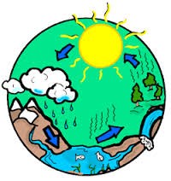
CONGRATULATIONS !!!!
CONDENSATION
EVAPORATION
RAINFALL
COLLECTION
YOU START FROM NEW

