Slide 1
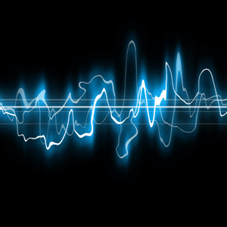
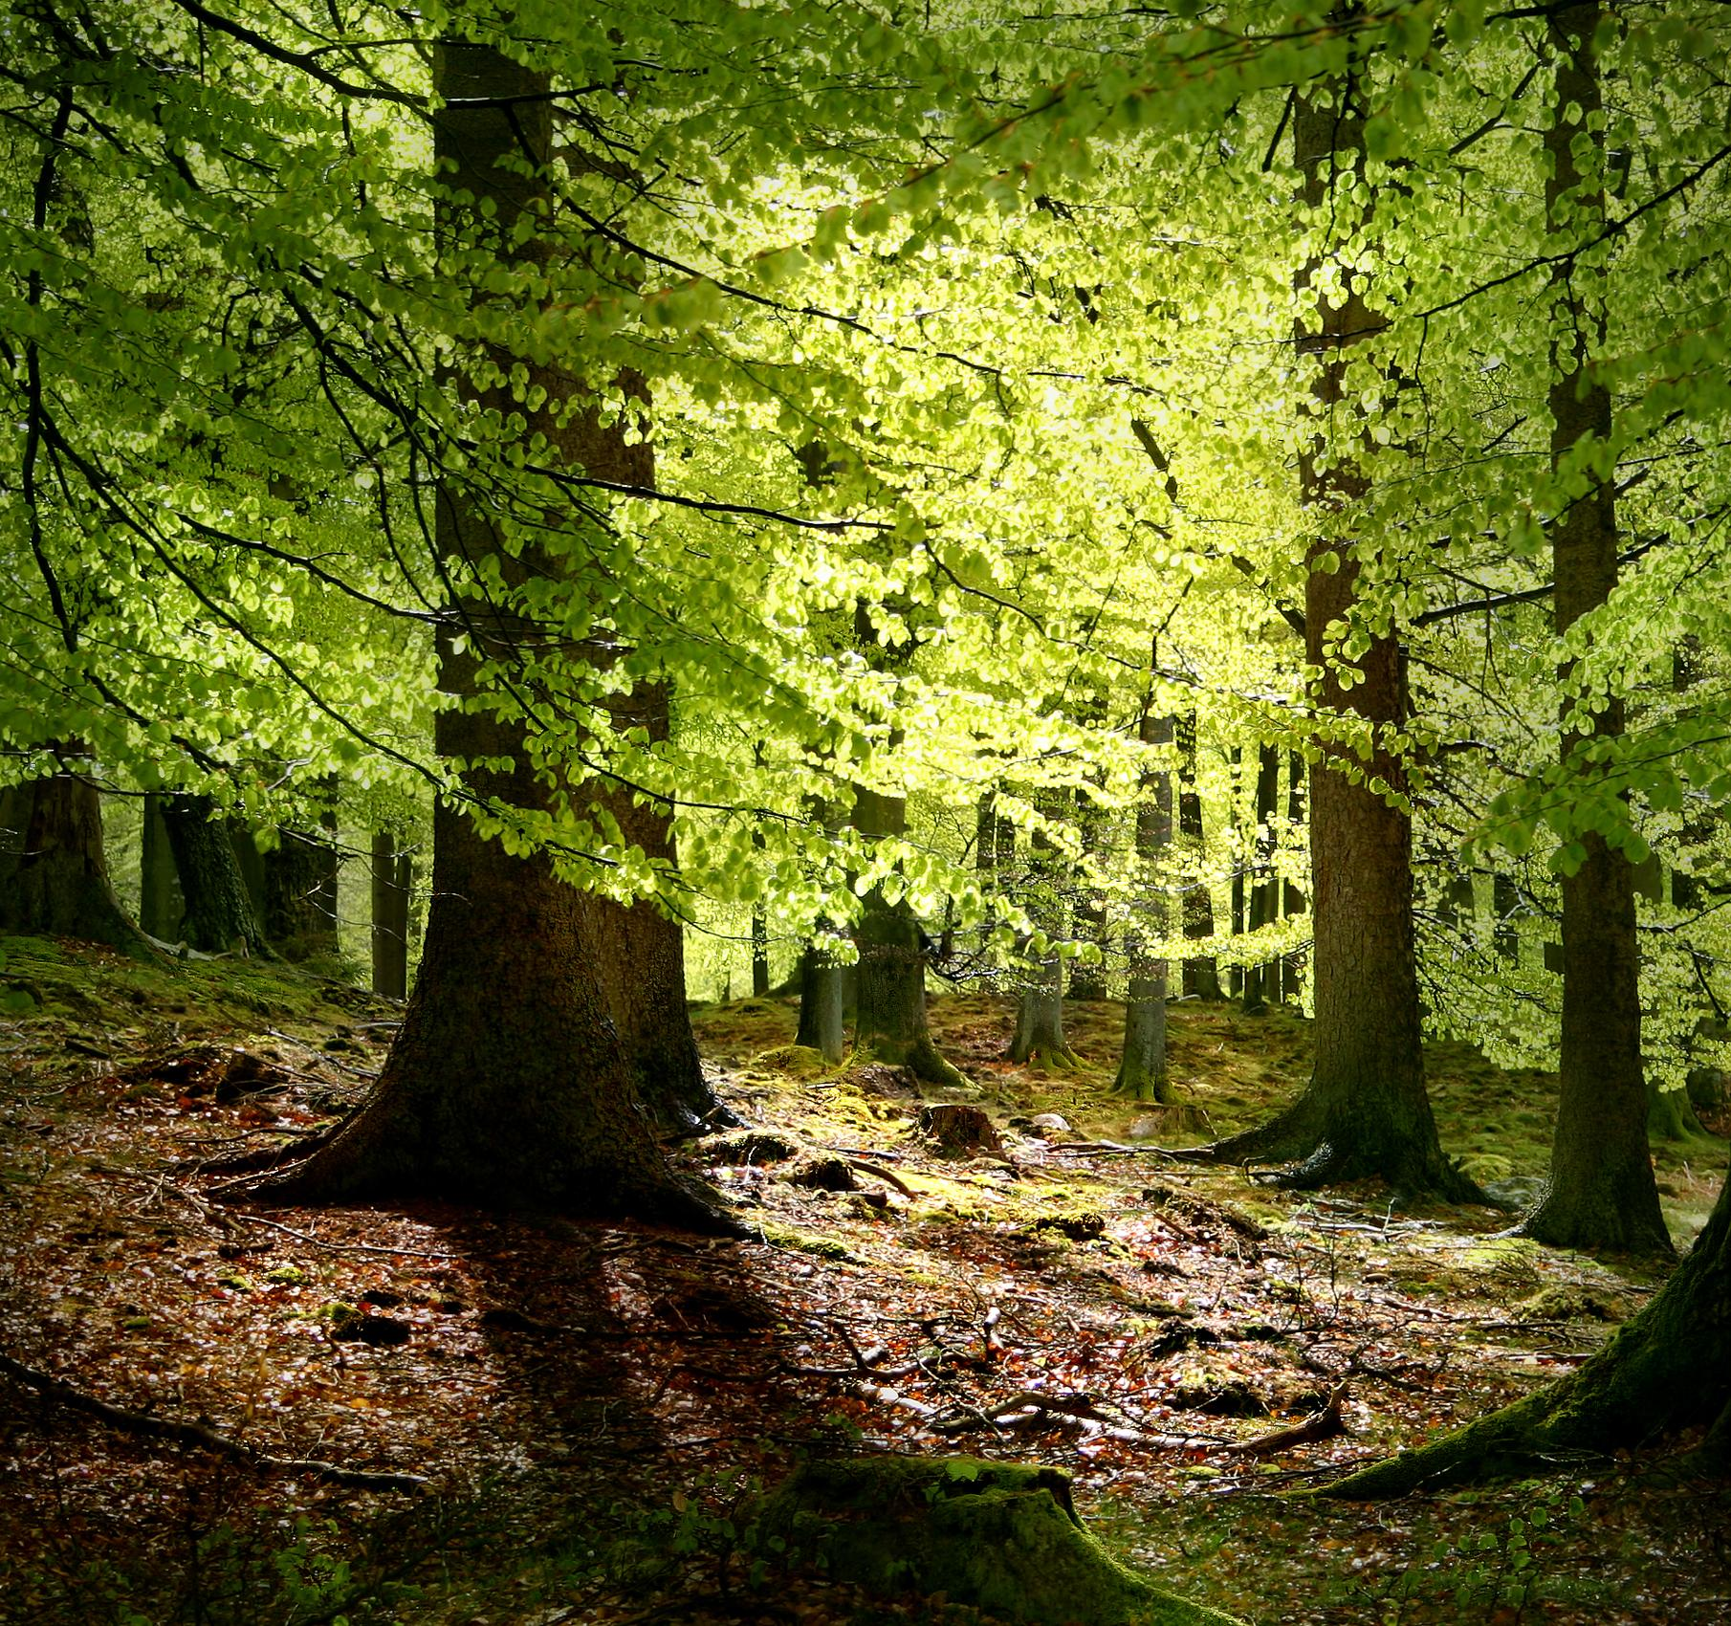
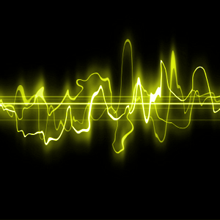
Acoustic Ecology & Soundscapes

Slide 2
1st Teaching period

Slide 3
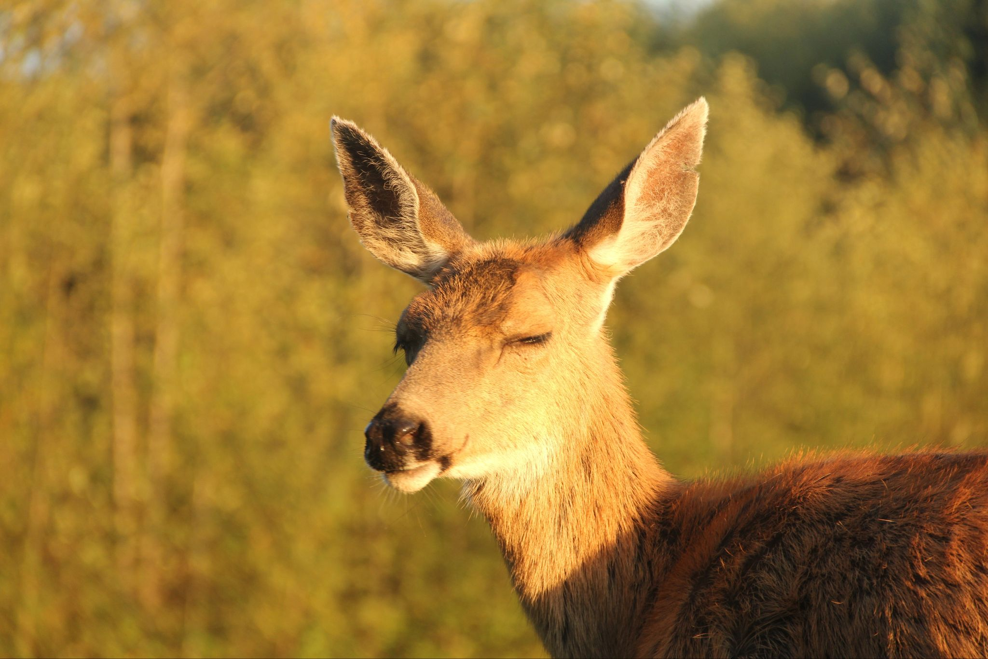
1st Activity Listening to the sounds-Understanding the classroom’s soundscape
Close your eyes for 1 minute. Listen carefully to all the sounds that you can hear, even the lowest ones, and try to understand:
Which sounds are produced inside the classroom and which are external?
Which sounds are made by you and which by your classmates?
Which sounds and how many of them are produced by the nature, or by humans, or by devices (technological sounds)?
How would you describe the sounds you hear? Are they pleasant, annoying, unpleasant, funny?

Slide 4
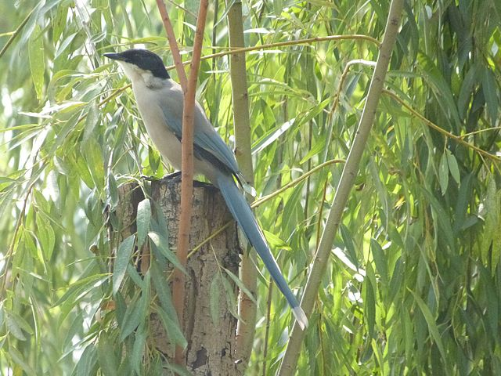
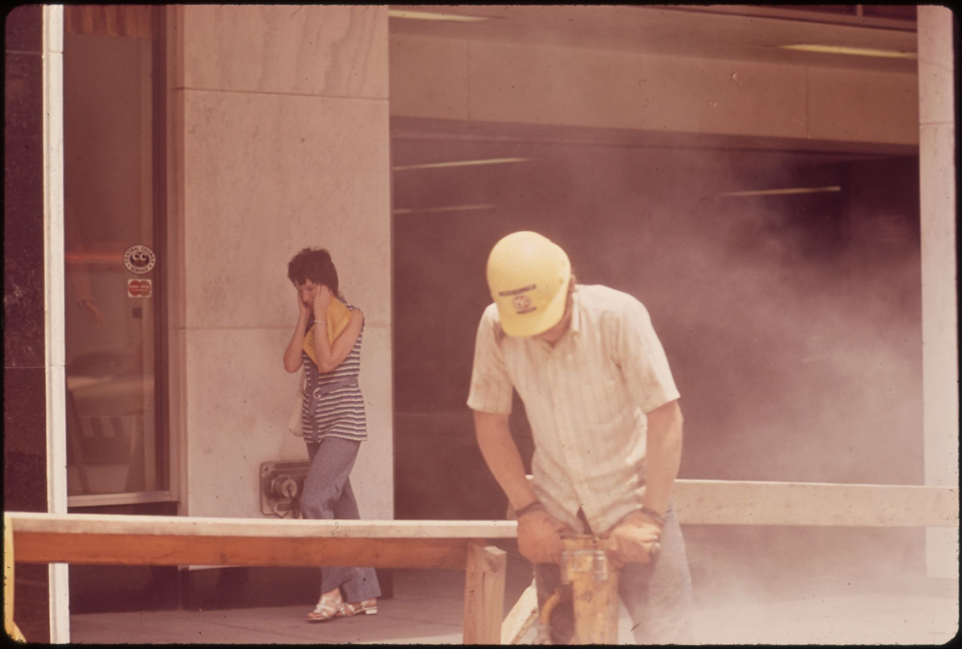
Acoustic Ecology
Acoustic Ecology, or Soundscape Ecology, is a broad research field which studies:
the relationship between human beings and their sonic environment and also
the effect of the sounds on all the creatures that inhibit the environment, plants, animals and humans.
Acoustic Ecology researchers study the reactions to the sounds and behaviors that maybe are caused by sounds and examine any possible imbalances within the sonic environment, which may affect health, such as noise pollution in the cities.

Slide 5
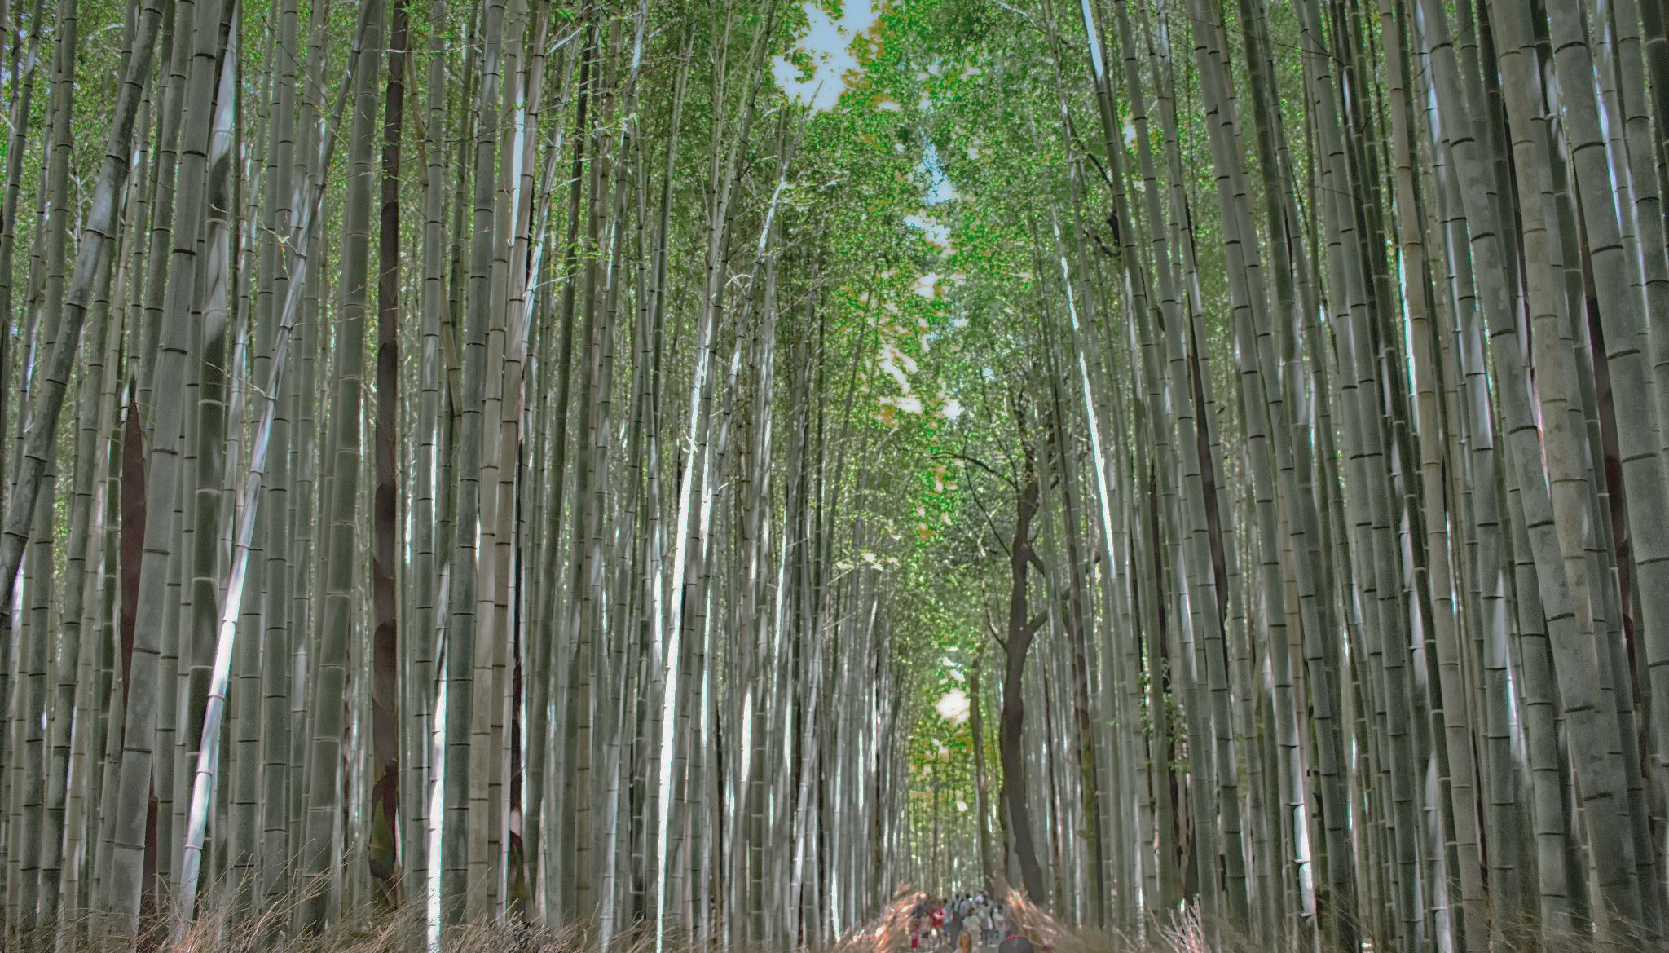
Soundscape
Soundscape is an environment made out of sounds, i.e. all the sounds we can hear at the moment form a soundscape! All the sounds heard in a forest create another soundscape.
The term Soundscape may refer to real sounds from the environment (natural or artificial) and also to works of art (music or sound compositions).
We, humans (and also the animals), perceive sonic environments in different ways, depending on hearing ability, sensitivity and experience.
We are also a part of our sonic environment, because we all produce sounds, adding to this big sound compilation.
Soundscapes can be easily altered, or even destroyed and extinct and they depend on many different elements, one of which is human activity and civilization.

Slide 6
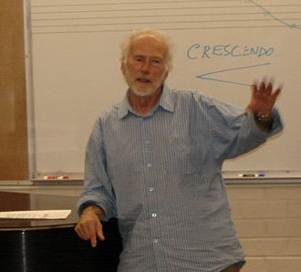
Raymond Murray Schafer
Raymond Murray Schafer (1933-2021), the “father” of Acoustic Ecology,
was a Canadian musician, composer, writer, educator
and environmentalist, who is famous for his work
World Soundscape Project, on Acoustic Ecology
and also his book The Tuning of the World (1977).
World Soundscape Project was an international research project
(1960s) at Simon Fraser University, Canada. Its goal was
"to find solutions for an ecologically balanced soundscape,
where the relationship between the human community and its sonic environment is in harmony."
The project initiated the modern acoustic ecology studies and included education about the soundscape and noise pollution, in addition to the recording and cataloguing of international soundscapes trying to preserve soundmarks, dying sounds and sound environments.

Slide 7
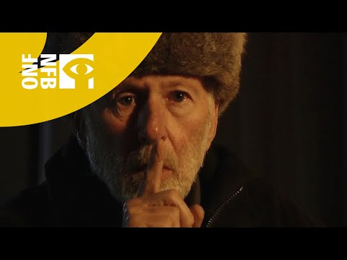
Listen, A video on R. Schafer and his ideas on sonic environment:
http://www.nfb.ca/film/listen/?fbclid=IwAR36qeaIx46onr75B6SmflBlF0NQHWKmN9Ps_tR7pg1lEBOjyeoB4wWBV1M

Slide 8
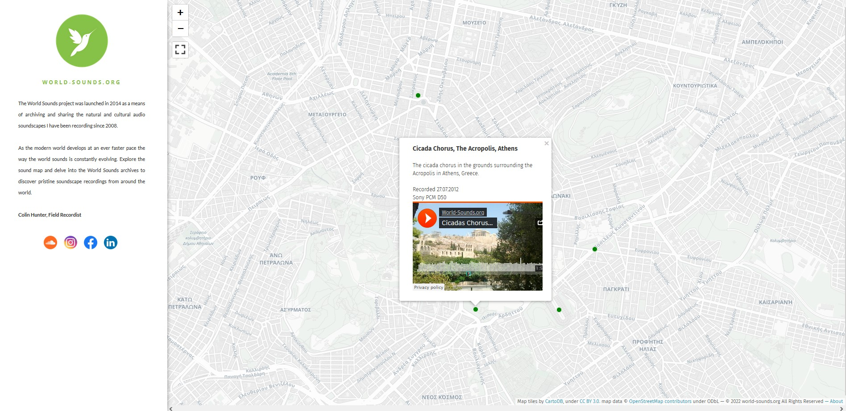
What is a Soundmap?
Soundmaps are digital maps which emphasise on the sonic representation of a place.
Soundmaps are created by connecting landmarks, such as railway stations, factories, forests, city squares, monuments, with recorded soundscapes.
Soundmaps are enriched maps which contain sound files created at the specific places. The soundmaps actually include the recorded soundscapes of each area of the map.
World Sounds is an example of a sound map. It is an online map of the Earth on which we can here recordings from various important places around the world.

Slide 9
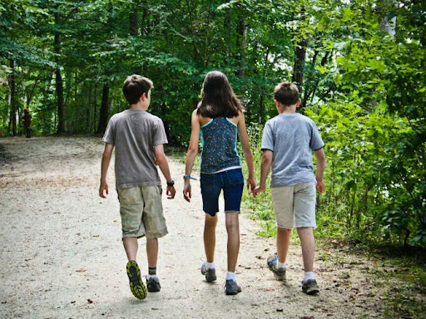
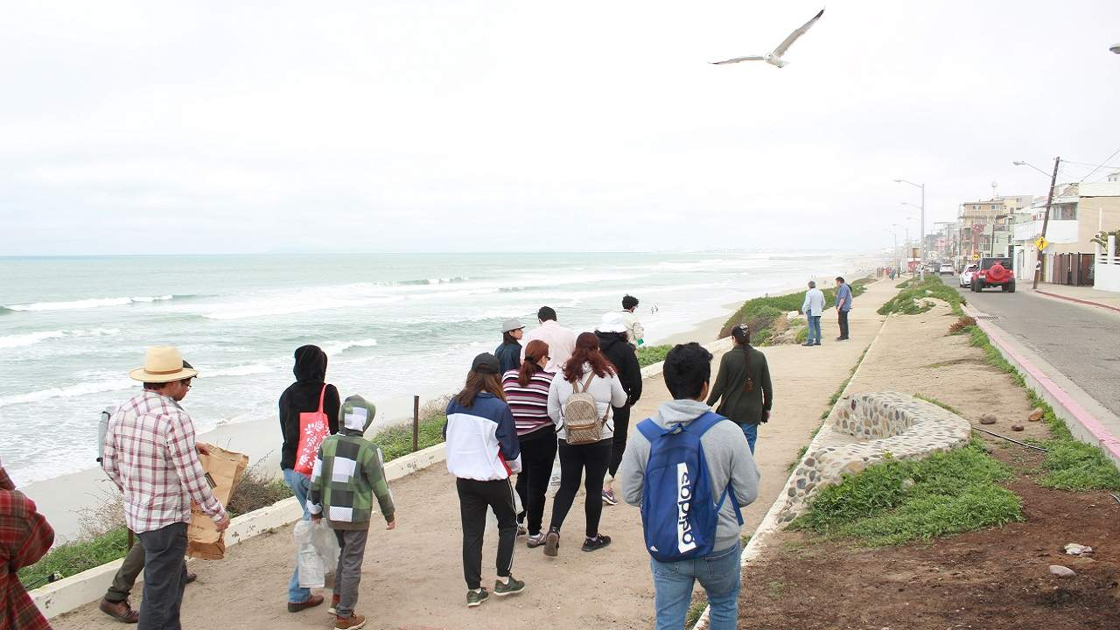
Soundwalk
This is a term by R.M Schafer used to describe the act of wandering around an area with the purpose of active observation and listening of sounds.
Soundwalks usually include data documentation (exact place, time, date, etc), recording of selected sounds and sometimes drawing or shooting photographs and videos.
The sonic material can be used with many different ways:
as inspiration for the production of artworks (sound composition, musical synthesis, painting, poetry, literature, comics, animation etc).
as an archival item (i.e, for the creation of a sound map)

Slide 10
Group Assignment
Creating Soundmaps with discovered sounds inside the school, or outdoors
The teacher and the class decide to organise a “soundwalk” and choose the place they want to work, inside or outside the school.
Every team (4-5 students) will have to document by drawing one soundscape that they believe is interesting. The team will have to discover the significant sounds of the chosen place and then write them down on paper. Afterwards one member has to draw a sketch of the specific area. The sounds will then have to be marked on the drawing, either with words, or with lines and colors. ie, an annoying noise (as the bell!) could be marked on the drawing of a schoolyard with yellow lines!
Every team will need a sketch pad, pencil and colors, two cell phones or tablets, and one free app for sound measuring, such as Sound-meter
Students will decide the role of each member of the team:
Who will draw the soundmap?
Who will record the sounds?
Who will write down all the necessary data? (place, date, time, sound source)
Who will measure with a decibel-meter app the intensity of the sound?
Who will put together the date and will form a presentation on padlet?
When documentation is over, the teams will have to publish the material they have produced on the padlet.

Slide 11
Human Beings & Sound Levels
Table 1
Type of Sound | Decibel
Normal Breath | 10
Leaves (very light wind) | 20
Quiet library, whisper | 30
Normal speaking, a quiet office, normal house life | 40
Traffic from a distance, Refrigerator, Quiet restaurant, light traffic
Air condition (6 m distance), conversation | 60
Heavy traffic, noisy restaurant | 70
Subway, Factory, telephone ringing | 80
Niagara falls, street with trucks, noisy devices (laundry, vacuum cleaner, etc.) | 90
Chainsaw, Jet airplane, very heavy traffic | 100
Rock concert (in front of the speakers), gunshot, drums | 120
Gun shot (close), Jet taking-off | 140
Spacecraft take-off | 180
Duration of Exposure (hours per day) | Maximum allowed sound level (dB)
8 | 87
4 | 90
2 | 93
1 | 96
1/2 | 99
1/4 | 102
You may download to your device the free application Sound Meter, for Android (in Google playstore), for metering the sounds you will study.

Slide 12
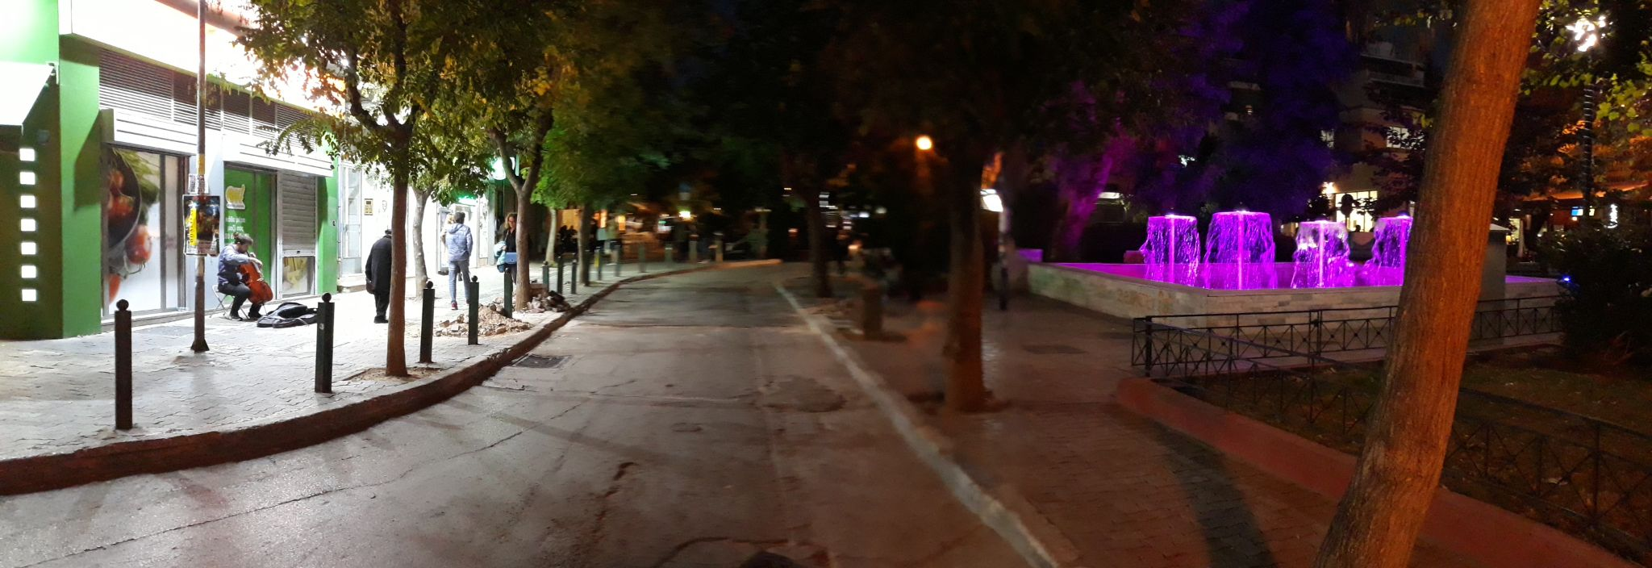
An example of a Soundscape documentation in the city (Athens).
Recording (with a cell phone) and photograph
Data: Cello & Fountain @ Fokionos Negri Square, Athens, November 3, 2021, 18:00 , duration 1:15.
https://drive.google.com/file/d/1D6aEFH9jLR-ermUZ9E3085W1hAeps2nI/view?usp=sharing

Slide 13
Challenge game!
The class is over. You may get up but…silently!!!
Can you get up from your seat, without making any sound at all?
Every time a sound is heard, the activity will stop and start over, from the beginning!!!
Be very careful! If you try this with great concentration, maybe we will hear less sounds in the class, but the result might never be completely silent!

Slide 14
Homework Sound & Memory
Under the tag “Sonic Memory”, at the padlet, you have to create a post with a small description of one sonic memory-a past event of your life, which you have connected with a special sound and was pleasant or unpleasant, funny or scary, etc. Don't forget to write your first name on your publication. You may also add a relevant image at your post.

Slide 15
2nd Teaching period

Slide 16
Team Work
Soundwalk, Recordings and Documentation

Slide 17
3rd Teaching period

Slide 18
Presentation
All the teams have to present their soundmap and recordings to the class, from the padlet.
You will present all the interesting facts you observed during your soundwalk, and will answer a few questions about your experience studying your soundscape.
Which were the most interesting sounds you heard?
Which one is the most outstanding sound of the soundscape you studied and why?
What kind of emotions were caused to you by the sounds you listened to?
Did you at any time have the chance to listen to these sounds before?
How would you describe the sounds you documented? Low-high, strong-weak, short-long, pleasant-unpleasant, etc)?
How high in the decibel scale were the sounds you recorded? Which are the corresponding example sounds in this area of decibel on table 1?
Do you have any recommendations for the improvement of these soundscapes you studied?
Do you have any recommendations for the improvement of the school’s soundscape?

Slide 19
Two minute evaluation
What is the most important thing i learned?
Which activity did i really enjoy?
What is my opinion on Acoustic Ecology?

Slide 20
Resources
Images
Grib skov, Malene Thyssen, CC BY-SA 3.0 <http://creativecommons.org/licenses/by-sa/3.0/>, via Wikimedia Commons. https://commons.wikimedia.org/wiki/File:Grib_skov.jpg
Soundwave, Luis Lima89989, CC BY-SA 3.0 <https://creativecommons.org/licenses/by-sa/3.0>, via Wikimedia Commons. https://upload.wikimedia.org/wikipedia/commons/b/b4/Sound_wave.jpg
Deer in field with eyes closed (head on view), ~riley, CC BY-SA 4.0 <https://creativecommons.org/licenses/by-sa/4.0>, via Wikimedia Commons.https://commons.wikimedia.org/wiki/File:Deer_in_field_with_eyes_closed_(head_on_view).jpg
Eyes closed - - (29441888736), Minda Haas Kuhlmann from Omaha, CC BY 2.0 <https://creativecommons.org/licenses/by/2.0>, via Wikimedia Commons, https://commons.wikimedia.org/wiki/File:Eyes_closed_-_-_(29441888736).jpg
Subway construction in downtown Washington, D.C. Noise from air compressors and jackhammers can cause irreversible... - nara - 544959, National Archives at College Park, Public domain, via Wikimedia Commons, https://commons.wikimedia.org/wiki/File:SUBWAY_CONSTRUCTION_IN_DOWNTOWN_WASHINGTON,_D.C._NOISE_FROM_AIR_COMPRESSORS_AND_JACKHAMMERS_CAN_CAUSE_IRREVERSIBLE..._-_NARA_-_544959.jpg
Peace Harmony Nature 30, Canno91, CC BY-SA 4.0 <https://creativecommons.org/licenses/by-sa/4.0>, via Wikimedia Commons, https://commons.wikimedia.org/wiki/File:Peace_Harmony_Nature_30.JPG
Sagano Bamboo Forest at Arashimaya - 3422189783, Ray in Manila, CC BY 2.0 <https://creativecommons.org/licenses/by/2.0>, via Wikimedia Commons, https://commons.wikimedia.org/wiki/File:Sagano_Bamboo_Forest_at_Arashimaya_-_34221897834.jpg,

Slide 21
Articles
Acoustic Ecology, https://en.wikipedia.org/wiki/Acoustic_ecology
World Soundscape Project, https://en.wikipedia.org/wiki/World_Soundscape_Project
Sites
http://www.akouse.gr/
World Soundscape project https://monoskop.org/images/7/7b/Schafer_R_Murray_A_Sound_Education_100_Exercises_in_Listening_and_Soundmaking.pdf
http://aesop.iep.edu.gr/node/12382/3157
http://sound.sch.gr/?fbclid=IwAR2JJNThLOolwZ9RQrxKYB_tUZ-csYJSJJg1MqPuIVfnZYk3o70vPMkvcIs
Recordings: https://aeinews.org/aeiarchive/recordings.html?fbclid=IwAR3XnkCyMHBSf0RVexxNuibrRY6PFUqtLcbBjeBgmkafKEnChIFXYOU8dp8
Sound Levels: https://teteleste.wordpress.com/2014/11/12/%CE%AE%CF%87%CE%BF%CF%82-%CE%B8%CF%8C%CF%81%CF%85%CE%B2%CE%BF%CF%82-%CE%B7%CF%87%CE%BF%CF%81%CF%81%CF%8D%CF%80%CE%B1%CE%BD%CF%83%CE%B7/

Slide 22
sites
http://sounds.bl.uk/sound-maps/
http://www.acousticecology.org/
http://wfae.proscenia.net/
http://www.sfu.ca/sonic-studio/srs/index2.html
http://gym-mous-tripol.ark.sch.gr/soundtrack/soundtrack.html

