Slide 1
C R A A P
CURRENCY
RELEVANCE
AUTHORITY
ACCURACY
PURPOSE
Sources of Information by Helixitta, CC BY-SA 3.0 , via Wikimedia Commons

Slide 2
X
CURRENCY
- When was the information published or posted?
- Has the information been revised or updated?
- Does your topic require current information, or will older sources work as well?
- Are the links functional?
CURRENCY
TIMELINESS OF THE INFORMATION
Example

Slide 3
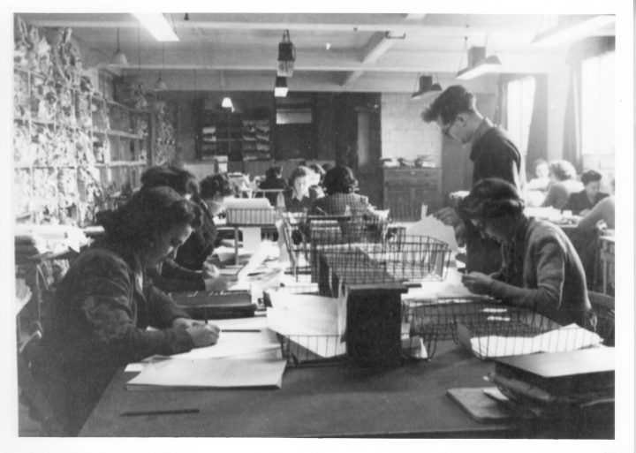
Example - Currency
X
In a project about WW2 students were asked to find information about the Enigma machine. A student gathered information from the following sources:
https://brilliant.org/wiki/enigma-machine/
https://bletchleypark.org.uk/our-story/the-challenge/enigma
Work in pairs to help the student verify the currency of the information sources
Answer the questions:
When was the information published or posted?
Has the information been revised or updated?
Does your topic require current information, or will older sources work as well?
Are the links functional?
Share your findings in the classroom Activity 1: Example - Currency
Hint: Although they are both valuable sources, they do not mention the date of creation and / or the last modification.
Attention: When it comes to primary sources, then accurate, yet historical, information is acceptable.
Women in Bletchley Park, UK Government, CC BY-SA 4.0 via Wikimedia Commons

Slide 4
X
RELEVANCE
- Does the information relate to your topic or answer your question?
- Who is the intended audience?
- Is the information at an appropriate level (i.e. not too elementary or advanced for your needs)?
- Have you looked at a variety of sources before determining this is one you will use?
RELEVANCE
IMPORTANCE OF INFORMATION FOR THE RESEARCH NEEDS
Example

Slide 5
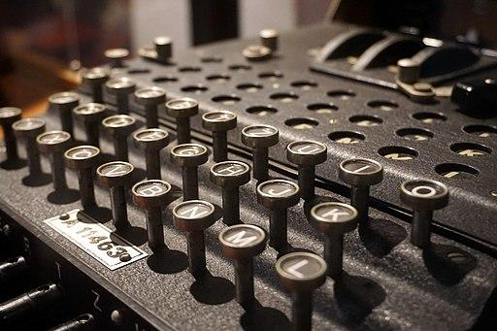
Example - Relevance
X
In a project about WW2 students were asked to find information about the Enigma machine. A student gathered information from the following sources:
https://plato.stanford.edu/entries/turing-machine/
https://en.wikipedia.org/wiki/Enigma_machine
https://en.wikipedia.org/wiki/Turing_test
https://en.wikipedia.org/wiki/Turing_pattern
http://sitn.hms.harvard.edu/flash/2012/turing-biography/
Work in pairs to verify the relevance of the sources
Answer the questions:
Does the information relate to your topic or answer your question?
Who is the intended audience?
Is the information at an appropriate level (i.e. not too elementary or advanced for your needs)?
Have you looked at a variety of sources before determining this is one you will use?
Share your findings in the classroom Activity 2: Example - Relevance
Nazi German Enigma Machine - 50416780478 Hohlgangsanlage 8, German WW2 Underground Hospital, Museum in St. Lawrence 2020 by mattk1979, CC BY-SA 2.0, via Wikimedia Commons

Slide 6
X
AUTHORITY
- Who is the author/ publisher/ source/ sponsor?
- What are the author's credentials or organizational affiliations?
- Is the author qualified to write on the topic?
- Is there contact information, such as a publisher or email address?
- Does the URL reveal anything about the author or source?
Note - to help answer Authority and Purpose questions, check out a website's About page
AUTHORITY
THE SOURCE OF THE INFORMATION
Example

Slide 7
Example - Authority
X
In a project about WW2 students were asked to find information about the Enigma machine. A student gathered information from the following sources:
https://plato.stanford.edu/entries/turing-machine/
https://brilliant.org/wiki/enigma-machine/
https://www.nbcnews.com/nbc-out/out-news/wwii-codebreaker-alan-turing-becomes-1st-gay-man-british-bank-note-rcna1251
http://sitn.hms.harvard.edu/flash/2012/turing-biography/
Work in pairs to help the student find out who the author is and what is his/her relationship with the subject (verify the authority of the sources)
Answer the questions:
Who is the author/publisher/source/sponsor?
What are the author's credentials or organizational affiliations?
Is the author qualified to write on the topic?
Is there contact information, such as a publisher or email address?
Does the URL reveal anything about the author or source?
Note - to help answer Authority and Purpose questions, check out a website's About page.
Share your findings in the classroom Activity 3: Example - Authority
Alan Turing: Life and Legacy of a Great Thinker by Christof Teuscher, CC BY-SA 2.0 via Flickr.com

Slide 8
X
ACCURACY
- Where does the information come from?
- Is the information supported by evidence?
- Has the information been reviewed or refereed?
- Can you verify any of the information in another source or from personal knowledge?
- Does the language or tone seem unbiased and free of emotion?
- Are there spelling, grammar or typographical errors?
ACCURACY
THE RELIABILITY, TRUTHFULNESS, AND CORRECTNESS OF THE CONTENT
Example

Slide 9
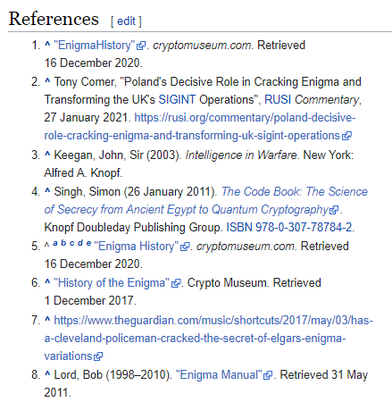
Example - Accuracy
X
In the following sources find out if there are references (e.g., citations, footnotes, or a bibliography) to sources that will provide evidence for the claims made:
https://plato.stanford.edu/entries/turing-machine/
https://brilliant.org/wiki/enigma-machine/
https://www.nbcnews.com/nbc-out/out-news/wwii-codebreaker-alan-turing-becomes-1st-gay-man-british-bank-note-rcna1251
Work in pairs to verify the accuracy of the sources
Answer the questions:
Where does the information come from?
Is the information supported by evidence?
Has the information been reviewed or refereed?
Can you verify any of the information in another source or from personal knowledge?
Does the language or tone seem unbiased and free of emotion?
Are there spelling, grammar or typographical errors?
Share your findings in the classroom Activity 4: Example - Accuracy
“References List” in Enigma Machine, from Wikipedia

Slide 10
X
PURPOSE
- What is the purpose of the information? Is it to inform, teach, sell, entertain or persuade?
- Do the authors/sponsors make their intentions or purpose clear?
- Is the information fact, opinion or propaganda?
- Does the point of view appear objective and impartial?
- Are there political, ideological, cultural, religious, institutional or personal biases?
Note - to help answer Authority and Purpose questions, check out a website's About page.
PURPOSE
THE REASON THE INFORMATION EXISTS
Example

Slide 11
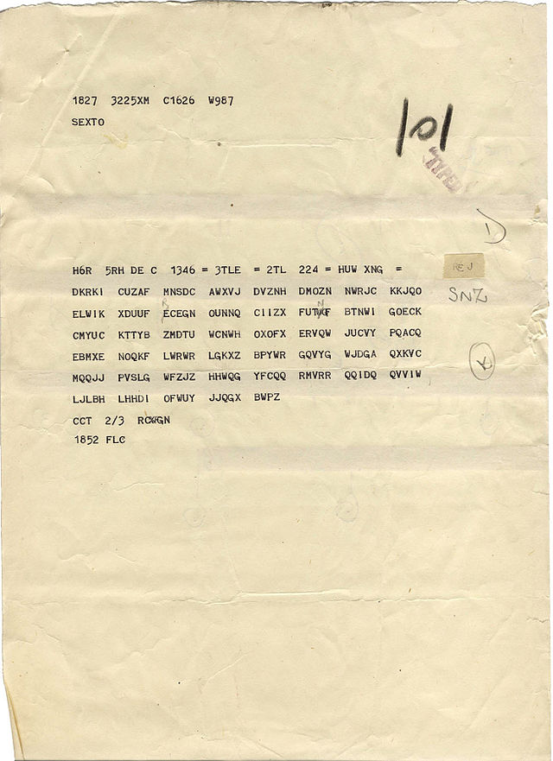
Example - Purpose
X
In a project about WW2 students were asked to find information about the Enigma machine. A student gathered information from the following sources:
https://www.bbc.com/news/business-57554102
https://brilliant.org/wiki/enigma-machine/
https://www.nbcnews.com/nbc-out/out-news/wwii-codebreaker-alan-turing-becomes-1st-gay-man-british-bank-note-rcna1251
https://www.amazon.com/Alan-Turing-Enigma-Inspired-Imitation/dp/069116472X
Work in pairs to help the student verify the purpose of the sources
Answer the questions:
What is the purpose of the information? Is it to inform, teach, sell, entertain or persuade?
Do the authors/sponsors make their intentions or purpose clear?
Is the information fact, opinion or propaganda?
Does the point of view appear objective and impartial?
Are there political, ideological, cultural, religious, institutional or personal biases?
Note - to help answer Authority and Purpose questions, check out a website's About page.
Share your findings in the classroom Activity 5: Example - Purpose
Typical Bletchley Intercept Sheet, by USAF, Public domain, via Wikimedia Commons

Slide 12
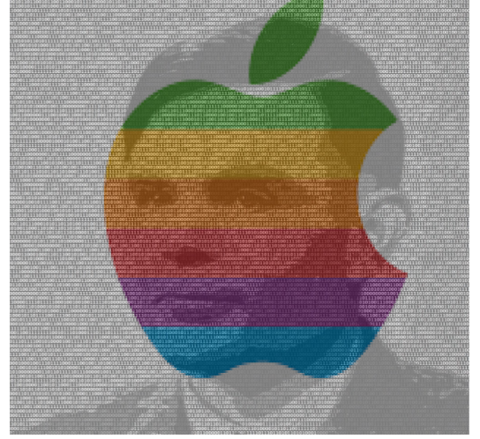
Group Activity - Is it a CRAAP?
X
In a project about WW2 students were asked to find information about Alan Turing. A student announces to the class that he has found some very interesting information about Alan Turing:
"The corporate logo of Apple computers is a poignant tribute to Alan Turing who was found dead at his home with a half eaten poisoned apple beside his bed."
Working in groups, you are asked to use the Source Evaluation Scorecard to evaluate the source presented by the student:
https://stmargarets.london/archives/2009/05/turings_poisoned_apple.html
Instructions
Open the Source Evaluation Scorecard
Connect to your Google account
Make a copy of the activity
Share your copy with your group
Work together to evaluate your source
Download your report as a .pdf document
Submit your work
“Turing and Apple logo” by Sofia Mougiakou, is licensed under CC BY-SA 4.0 based on “Apple Inc.”, Public domain, via Wikimedia Commons and “Alan Turing: 'Father of computer science, mathematician, logician, wartime codebreaker, victim of prejudice’”, Public domain, via Flickr.com

