Slide 1
ENTREPRENEURSHIP AND INNOVATION
Marketing & Management
Marketing goals
Determining turnover (total net sales) for the first 3 years.
Creating and consolidating customer-oriented infrastructure and image.
Creating new, innovative channels and mechanisms for initial and repeat sales.
Creating cooperation & loyalty mechanisms in the B2B (Business to Business) & B2C (Business to customers) sector.

Slide 2
ENTREPRENEURSHIP AND INNOVATION
Marketing & Management
Marketing strategy
1. Introduction to the product.
2. Creating interest.
3. Product utility.
4. Creating bonds of mutual interest and benefit between business and customers.
5. Initial & repeat purchase of the product.

Slide 3
ENTREPRENEURSHIP AND INNOVATION
Marketing & Management
Marketing mix (4P)
Marketing mix
The philosophy and content of marketing decisions and operations are expressed through the term "marketing mix" - a system of closely linked variables, designed to meet the needs of consumers and the goals of a business.
These variables are known in the literature as the "4Ps", i.e. product, price, place and promotion.

Slide 4
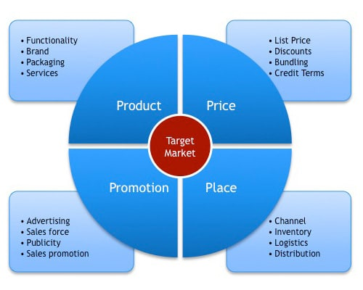
ENTREPRENEURSHIP AND INNOVATION
Marketing & Management
Marketing mix (4P)

Slide 5
ENTREPRENEURSHIP AND INNOVATION
Marketing & Management
SWOT Analysis
SWOT Analysis
SWOT analysis is a strategic planning tool used to analyze the internal and external environment of a business, when the company has to make a decision in relation to the goals it has set or the achievement of its goals.
The acronym SWOT derives from the words: Strengths, Weaknesses, Opportunities, Threats

Slide 6
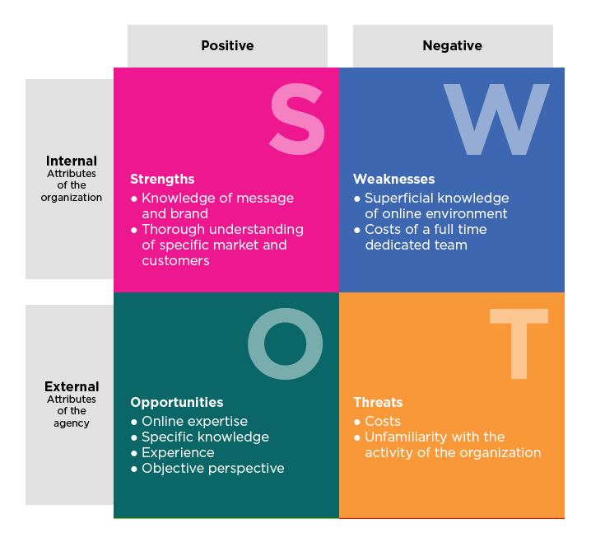
ENTREPRENEURSHIP AND INNOVATION
Marketing & Management
SWOT Analysis

Slide 7
ENTREPRENEURSHIP AND INNOVATION
Marketing & Management
Management
Functions of Management
Planning
Controlling
Directing
Organizing

Slide 8
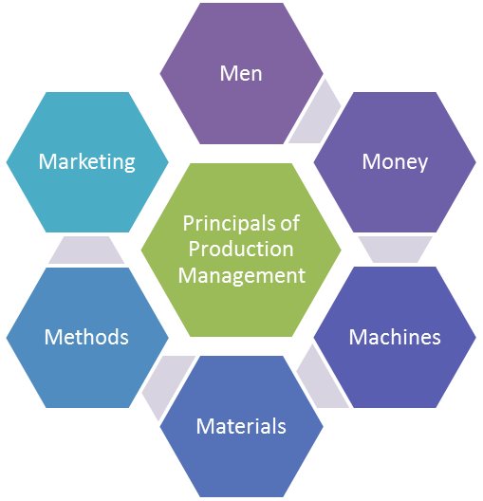
ENTREPRENEURSHIP AND INNOVATION
Marketing & Management
Management
In the American literature, the factors of Management are referred to as the "Six M" (because their initial is M):
1) Μen
(2) Materials
(3) Machines
(4) Methods
(5) Money
(6) Marketing

Slide 9
ENTREPRENEURSHIP AND INNOVATION
Marketing & Management
Basic leadership skills
Ability to act as an inspirer and motivator for team members.
Communication skills.
Ability to gain and develop knowledge.
Ability to analyze environmental trends and forecast.
Ability to select and maintain the right partners.
Ability to make participatory decisions.
Ability to transfer authority and delegate tasks.
Ability to conceive, plan and implement changes.
Ability to act as an inspirer and motivator for team members.
Ability to evaluate and reward.

Slide 10
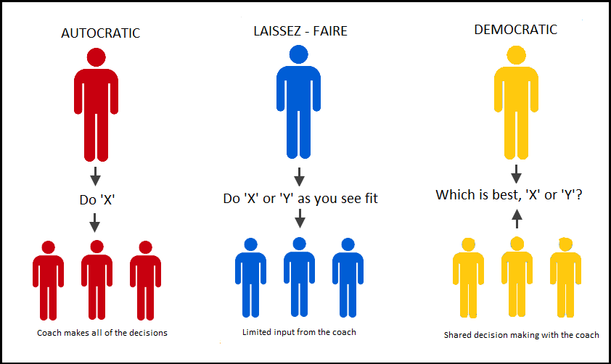
ENTREPRENEURSHIP AND INNOVATION
Marketing & Management
Leadership style

Slide 11
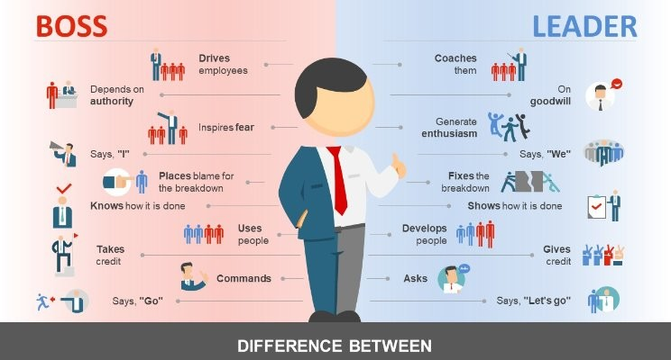
ENTREPRENEURSHIP AND INNOVATION
Marketing & Management
Difference between Leaders & Managers

